Slide 1
Github Training

Slide 2

Modules to be covered
GitHub Overview
Key Git Concepts
Other GitHub Features
Using CoPilot effectively
Codespaces
Exploring other Github products

Slide 3
GitHub Overview

Slide 4


Git vs GitHub
Git keeps track of changes to a codebase or project. Github helps teams share and manage these changes.
Created by Linus Torvalds in 2005, Git is a distributed version control system.
It operates locally and invoked through commands.
Git exists without Github.
Developed by Microsoft, Github provides an online space to store repositories and foster collaboration amongst teams.
Enhances Git with additional features including seamless integration with other online tools.
Github cannot work with Git.

Slide 5
Github Enterprise Cloud
ABUHB uses Github Enterprise
  Our organisation differs from a personal Github free account.
  Access is controlled through the organisation and admins set policies for repositories, codespaces, CoPilot usage and other features.
What Github Enterprise provides
  Ability to enforce branch protection and need for reviews on private repositories
  Centralised user management and permissions
  Full auditability of log-ins and compliance reporting
  Increased governance over code

Slide 6
Why Github for analytics?
Faster development
  Removes technical barriers for collaborative work.
  Ability to reuse shared codes and resources.
Enhanced security
  Share code securely within approved protocols
  Ability to add advanced security checks on code and analytics.
Collaboration and auditability
  All code lives in repositories – not emails, Sharepoint or personal folders
  Every change can be traceable and version history easily documented
  Ability to rollback changes – no need for manual backups
Single source of truth
  One canonical repository per project or product (with ability to fork/clone repos if required)
  Ability to add protection to production resources – only reviewed code can reach production
  Better quality assurance and knowledge transfer

Slide 7
Github Usage Best Practices
Avoid making key changes in the main branch – develop in dedicated feature branches with consistent naming.
Utilise pull requests (PRs) to improve code quality and knowledge sharing.
Write meaningful commit messages – makes versioning and history of code easier to understand
Every repository should have a README.md that explains:
Purpose of the project
How to run it and its dependencies
Key contacts
Use Issues and Projects for clear collaborative tracking.

Slide 8
Navigating a repository
Key tabs:
Code – where all code and documentation is stored
Issues – raise bugs/tasks for developers to work on
Pull requests – review changes before merging
Agents – Ability to create custom agents to automate workflows
Actions – ability to add automated workflows and checks
Security & Alerts – ability to add credential scanning, data quality and dependency checks
Projects – Kanban board(s) for planning and tracking activities
Insights – contributor and activity statistics

Slide 9
Exercise Checkpoint 1
Navigate through Github to find the training repo and your dedicated workspace.
  Sign into Github with your account (you may be asked to authenticate via Microsoft Authenticator).
  Search for the following repository in ABUHB’s main page: biu_GitHub_Training
  Open the participants folder and find your folder named firstname-lastname.

Slide 10
Key Git Concepts

Slide 11
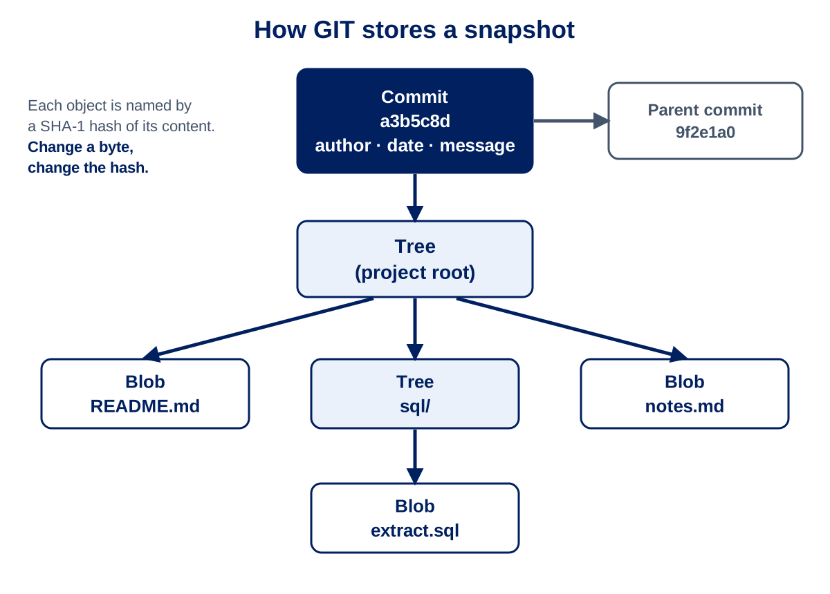
How Git Stores Your Work
The Object Model
Blob – file content (your code)
Tree – directory structure
Commit – a snapshot of your code with metadata
GIT stores snapshots of the whole project, not just differences.
Objects are addressed by a SHA-1 Hash – all changes have a unique hash.
All changes are performed using underlying git CLI code.

Slide 12
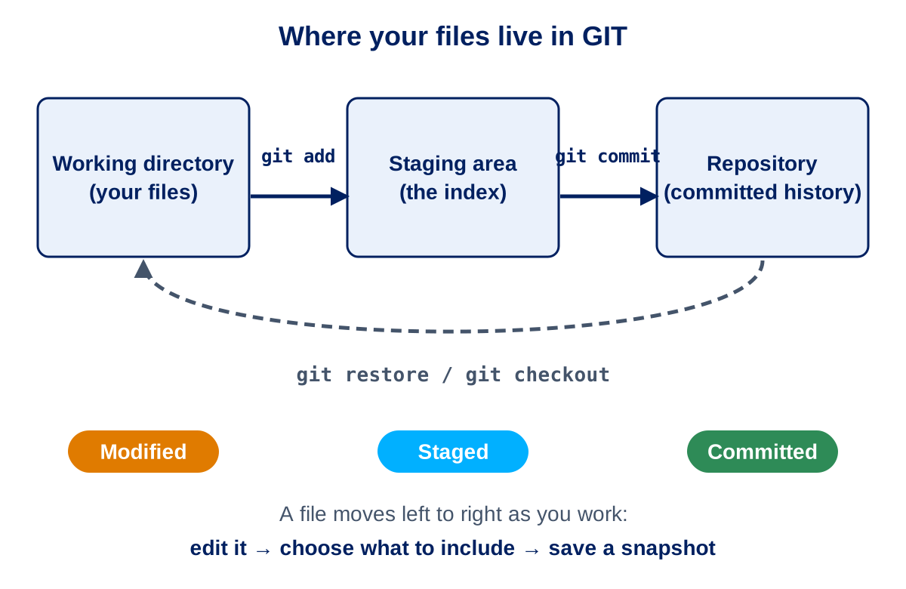
How Git Stores Your Work
Your files will live in three places:
Working directory – where you edit the files
Staging area – you can control what changes can then go into the next commit
Repository – what changes have been committed into history

Slide 13




How Git Stores Your Work
Github
Github
Your local workspace/desktop
Commit hash: a3bcde
Original document
Copy of original document
Adjusted document
Adjusted document
PULL into your branch
Commit your changes
Push your changes into Github
Main/Production
Your dev branch
Your dev branch
Your dev branch
New version overwrites old version. Ready for new developer to pull!
Commit hash: b4fhef
New version of document
Reviewer approves pull request
Unreviewed document
Open a pull request for review!
Main/Production
Your dev branch

Slide 14
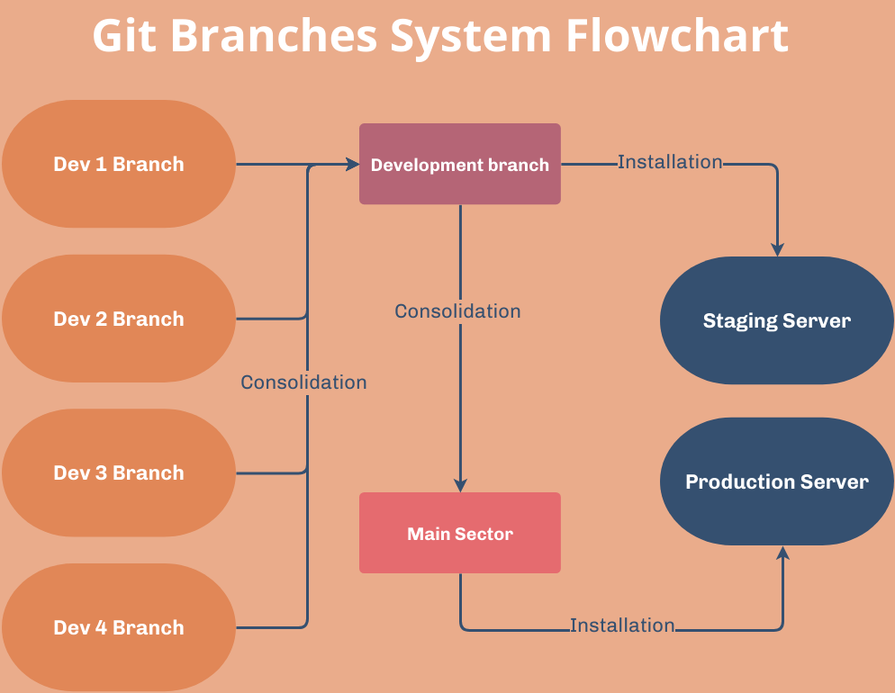
How Git Stores Your Work

Slide 15

Standard Github Files
All GitHub Repositories should contain the following:
A README markdown file.
A .gitignore file.
A .gitkeep file to create an empty folder if required.
.gitignore tells Git which files and folders should not be stored in a repository. Examples include credentials, cached data, log files (which could expose sensitive information) and local developer settings.

Slide 16
Exercise Checkpoint 2
Create your feature branch and fill in your README.
  In Github, create your own feature branch.
  Open your README in your participant folder and fill this in.
  Stage and commit this with the message: Fill in my area README.

Slide 17
Other GitHub Features

Slide 18
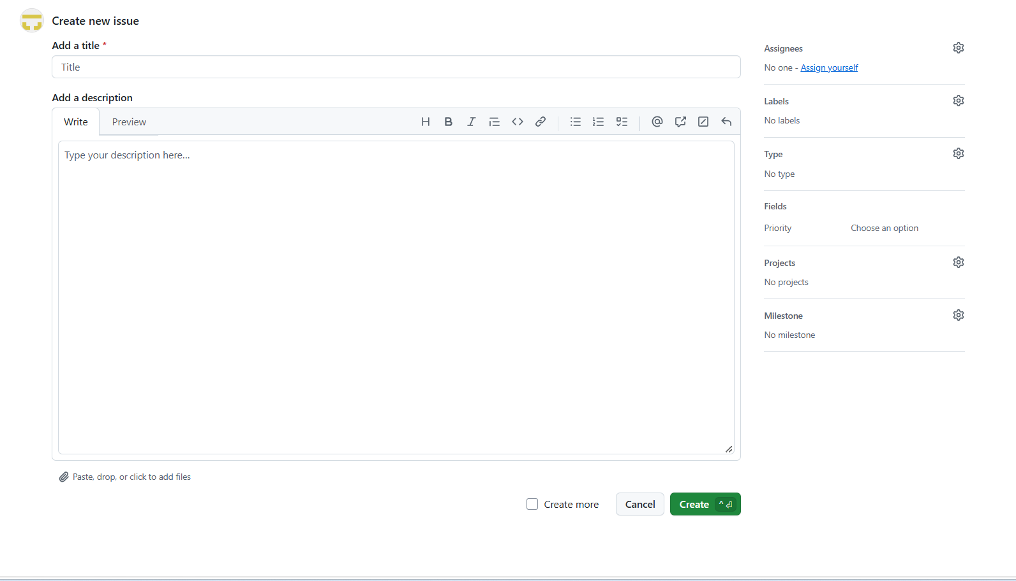
Issues
Github Issues are digital task cards used to track work, bugs and request improvements/suggestions within a software project.
Issues can be linked to agentic working – once an issue has been raised, an agent can then complete the work and open up a pull request for a human to review.
Encourages collaboration and better organisation – provides history of decisions and assignment of work to team members.
Templates can be set up to standardise requests/bug issue forms.

Slide 19
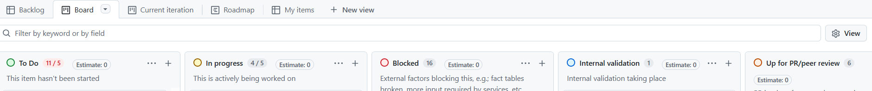
Projects
Resembles a Kanban/devops board that managers can link issues/tasks to key milestones and task phases.
Automatically move and assign tasks to users using agents/Github actions.
Allows for work and delivery in one place with real-time progress tracking.
Supports agile way of working with prioritisation and sprint tracking.

Slide 20


Agents and Actions
Actions – automated tasks that follow pre-defined instructions by users, e.g.; running data quality checks, sending an email, etc.
Agents – custom built AI workers that can automate recurring business activities and free up staff to work on more strategic work.
An action automates a task. An agent automates a responsibility.

Slide 21
Using CoPilot Effectively

Slide 22
Using CoPilot Effectively
Functions the same as 365 CoPilot.
Enables users to ground prompts in specific codebases and enables users to pin resources/files to the query window to generate more relevant and accurate responses.
The organisation being an enterprise allows users to select which language model to use for query and development.
GitHub CoPilot allows for agentic working and planning projects whereas 365 CoPilot can only answer questions.
Widely accessible within Github.

Slide 23
Using CoPilot Effectively
Get better answers
Give context – the columns, the metric definition and the output you want.
Work in small steps and iterate.
Ask CoPilot to explain code you do not understand.
You are the reviewer! Not the agent!
Give me SQL.
Create a SQL snippet using the file *** to determine how many patients were in A&E last month.

Slide 24

Using CoPilot Effectively
Agentic CoPilot can take a prompt, plan steps and complete actions to achieve this.
“Make my SQL script more efficient.”
Standard CoPilot response to prompts.
“What is this SQL script doing?”

Slide 25
Exercise Checkpoint 3
In your participant folder in your feature branch, there is a .py script. Open this and work with CoPilot to understand and optimise the script.
  Open the PY file in your feature branch in Github.
  Use the following prompt within CoPilot: please explain what this file is doing.
  Ask CoPilot to make suggestions on how to improve the file.
  Use the following prompt in Agent Mode to generate a technical document: create a technical document to explain this file.
  The agent will potentially produce this within its new feature branch. Open a pull request to pull these changes into your feature branch.

Slide 26
Codespaces

Slide 27
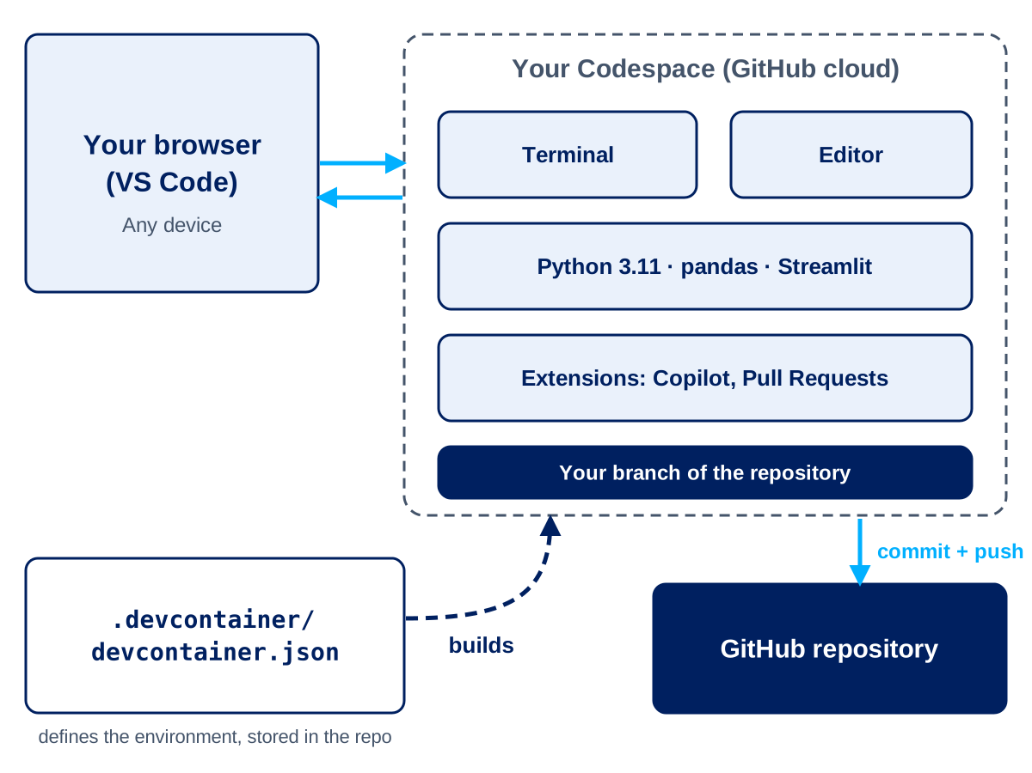
Codespaces
VS Code within the cloud
A ready-to-use development environment, opened from a repository in your browser.
Python packages and extensions are already pre-installed.
Integrated with CoPilot and Github.
Why use compared to local VS code?
Everyone in the team gets the same environment.
Great for onboarding, quick fixes and reviewing pull requests in one place.

Slide 28
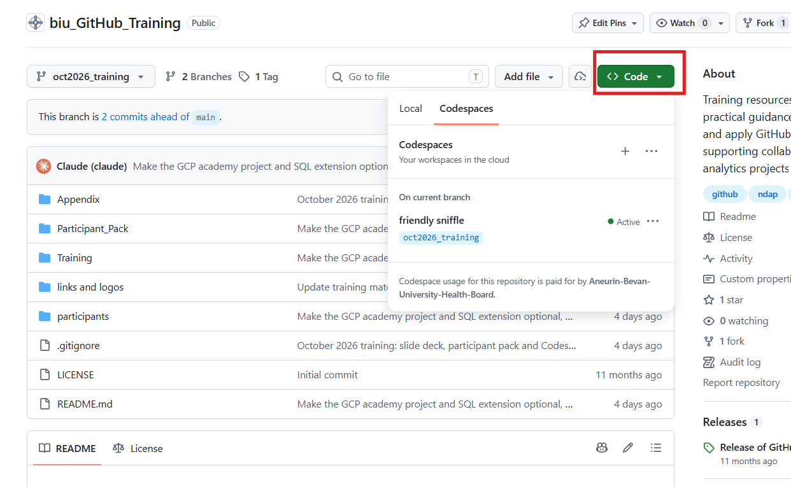
Codespaces
Will open in separate browser window for users without VS Code.
Can be accessed through VS Code locally.

Slide 29
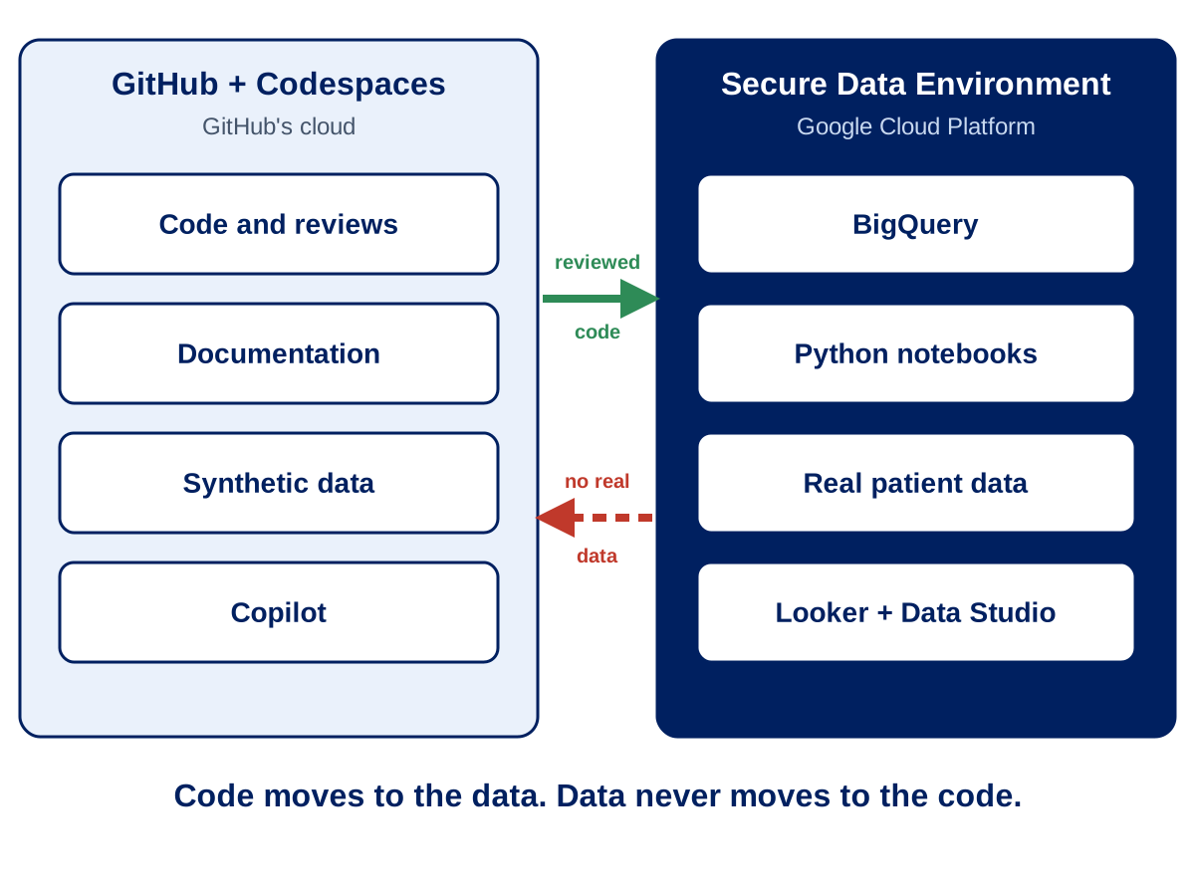
Codespaces

Slide 30
Codespace Walkthrough

Slide 31
Exercise Checkpoint 4
Open up a codespace in your feature branch and use CoPilot as an agent to help troubleshoot a badly written SQL script.
  Create a new codespace in your feature branch in GitHub. Your codespace URL is randomly generated so will not be the same as your neighbour!
  In your participant folder, there is a .sql file. Use CoPilot in Ask mode to review the file.
  Revert CoPilot into Agent mode and prompt it to fix the errors in your file.
  Ask CoPilot to generate a document to explain the SQL code.
  Commit and push your changes out of the codespace into GitHub.

Slide 32
Other GitHub products

Slide 33

Useful Resources
You should have access now to the full BIU_GithubTraining repo.
Halo ticket for new GitHub requirements: ABUHB Self-Service Portal – GitHub
NHS Wales Solution Exchange: NHS Wales Solutions Exchange - Browse Solutions
Speak to a member of the GitHub Admin team!

Slide 34
Thank you!

